Slide 1
Wireshark Tutorial
EL9333 Supplemental material for Lab 1

Slide 2
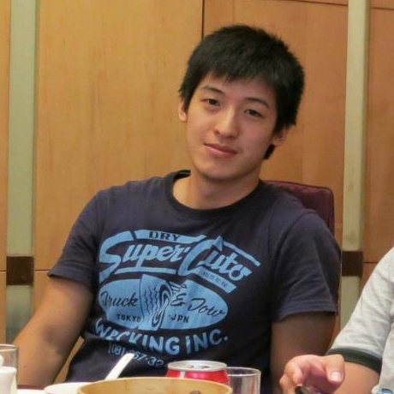
Meet the TAs
Cing-Yu (Frank) Chu
cyc391@nyu.edu

Slide 3
Lab Sessions
Time: Friday 4 – 6 pm, every week
Location : LC001 (B1 of the library building)

Slide 4
About Labs
Grouping
Labs can be done in a group of 2 people.
Each group should only submit one copy report.
Each lab starts after the lab lecture
Deadline of each lab is before the start of the next lab
Changes may be made to fit exam and school schedule

Slide 5
Lab1 Objectives
Master the network measurement tool: Wireshark
Get fundamental understanding of cloud computing
Understand a typical cloud-based storage service: Dropbox & Google Drive
Observe the interactions between a Dropbox client and the cloud using Wireshark
Compare Dropbox and Google drive

Slide 6
Wireshark
A “Packet Sniffer”: The basic tool for observing the messages exchanged between executing protocol entities.
Store and/or display the contents of the various protocol fields in these captured messages.
Passive packet sniffer: Observes packets sent and received to the machine, never sends packets by itself.
Packet Analyzer: A component of packet sniffer which displays the contents of all fields within a protocol message.

Slide 7
Typical Packet Sniffer

Slide 8
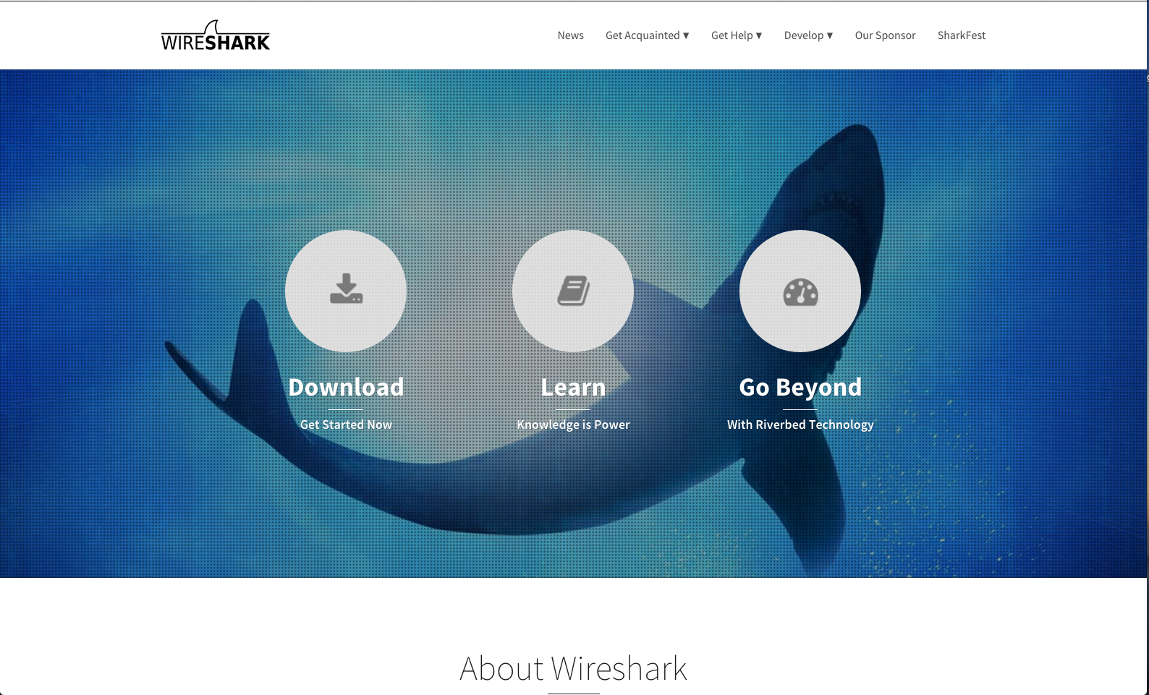
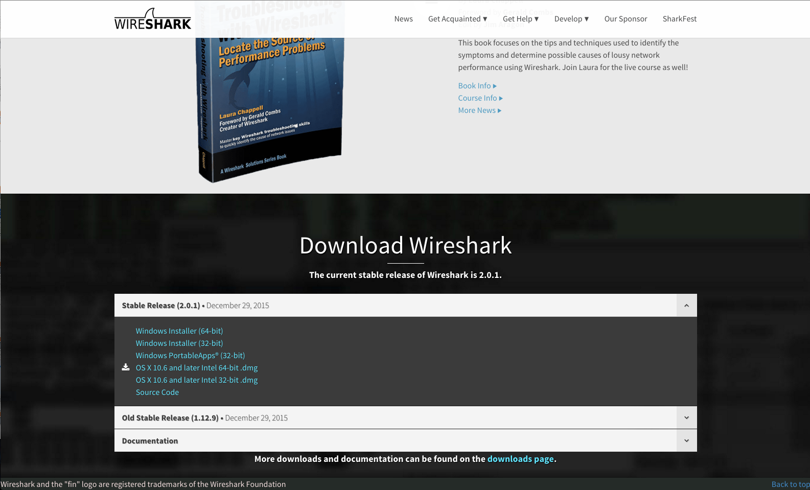
Download Wireshark
Visit
https://www.wireshark.org/

Slide 9
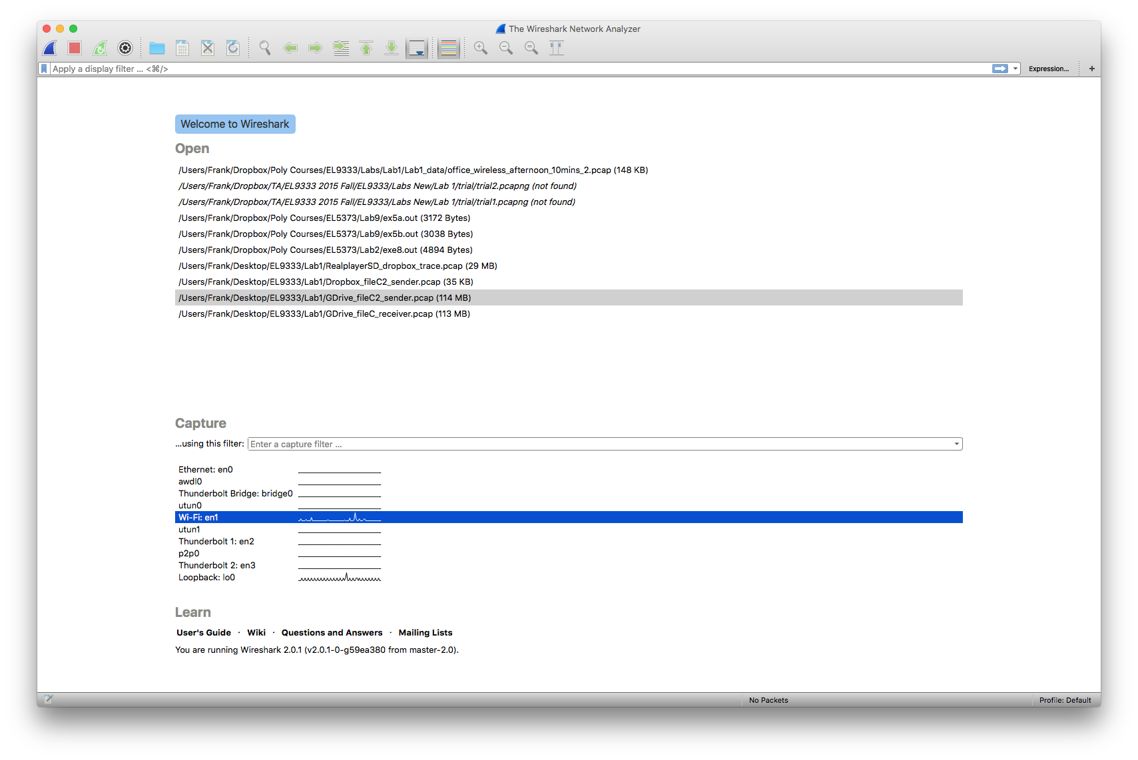
Start Wireshark

Slide 10
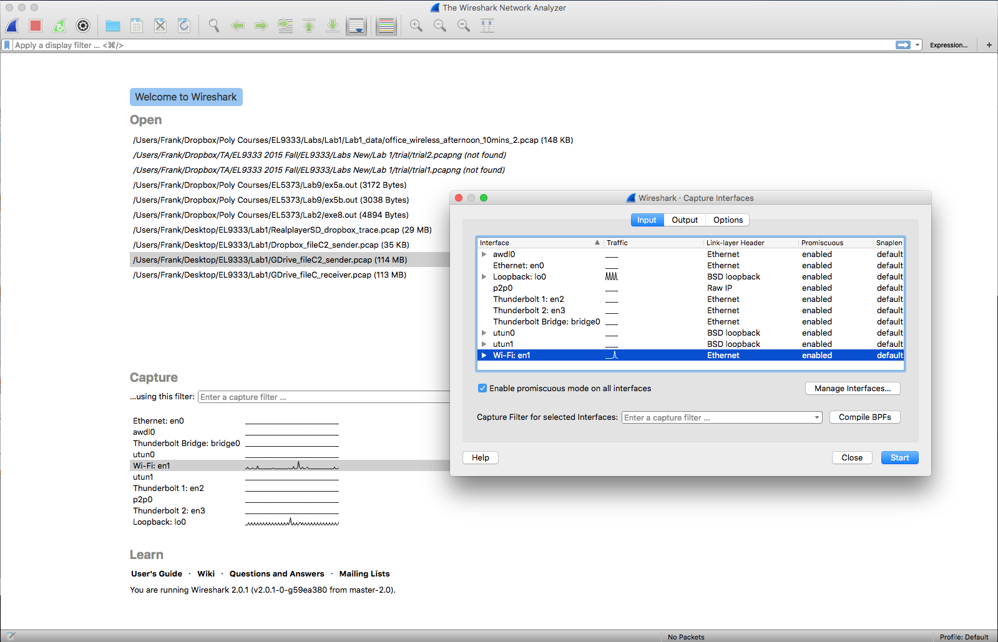
Choose Interface

Slide 11
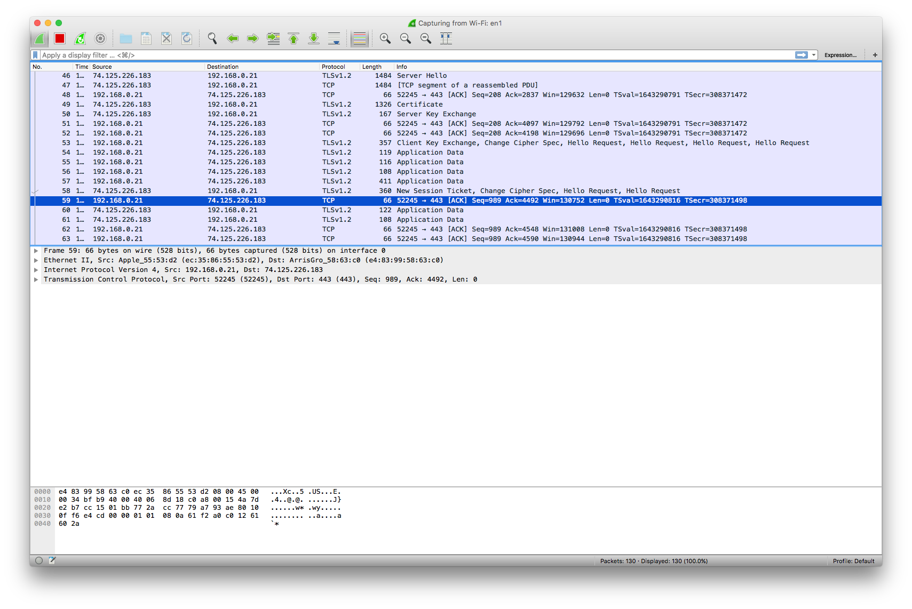
Captured Packets

Slide 12
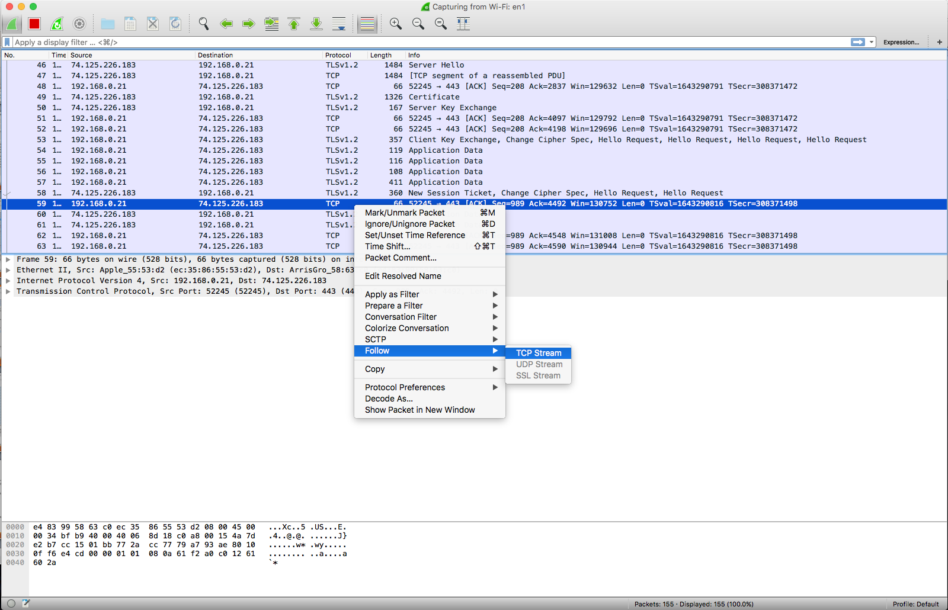
Follow a TCP Stream

Slide 13
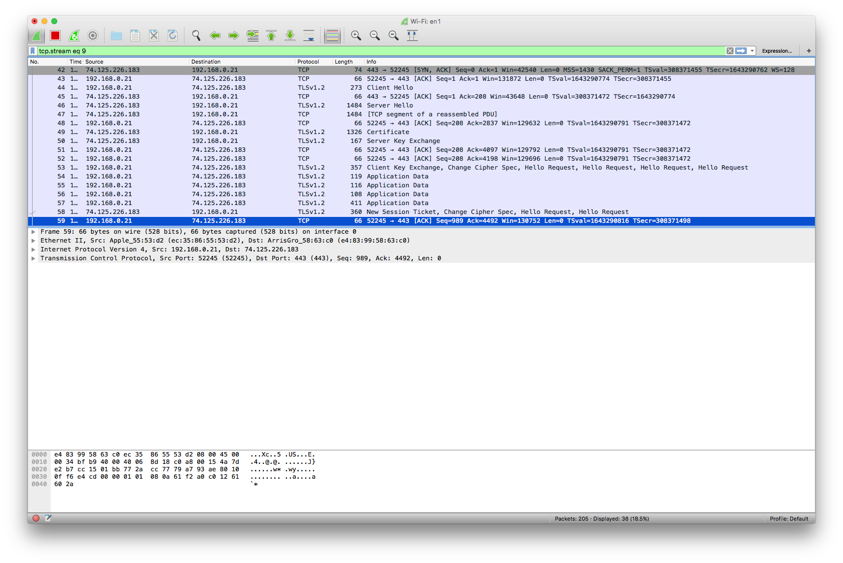
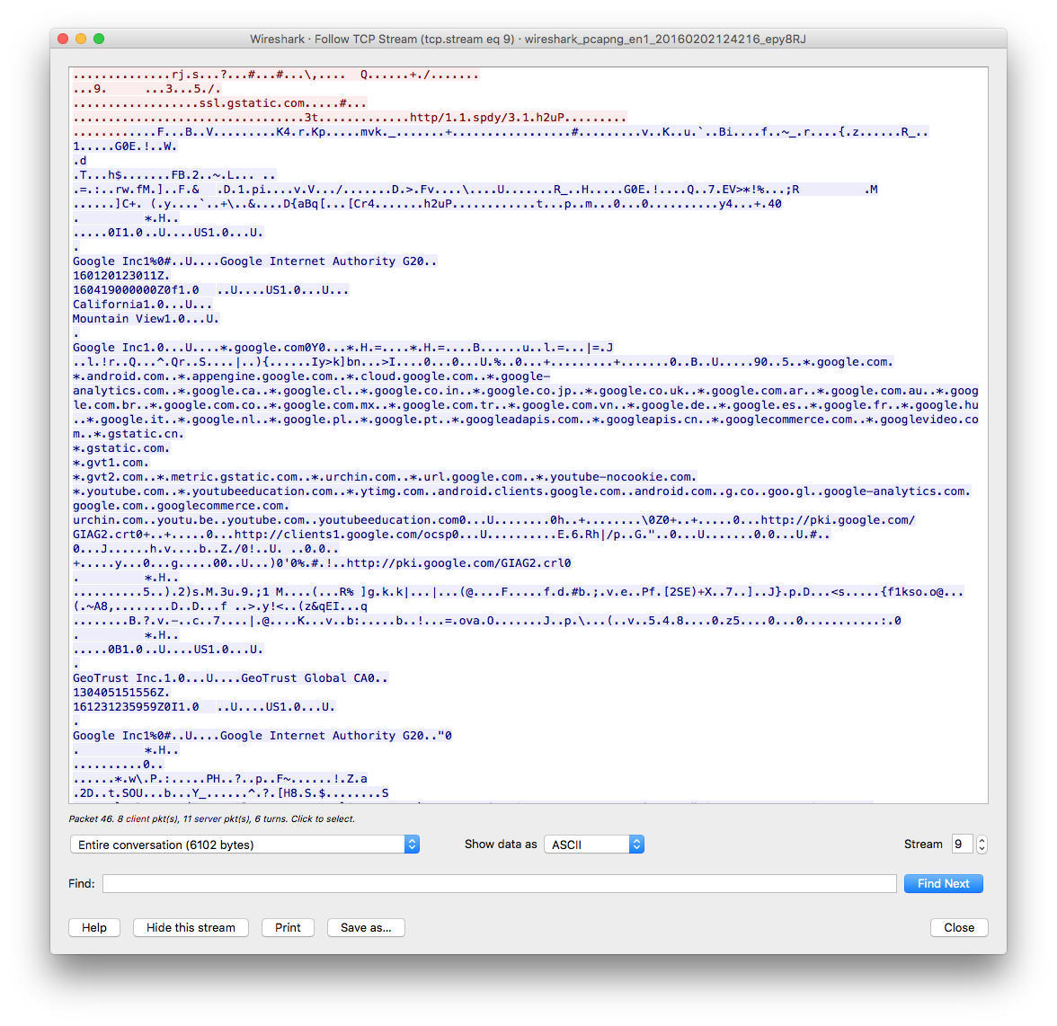
Certain TCP Stream

Slide 14
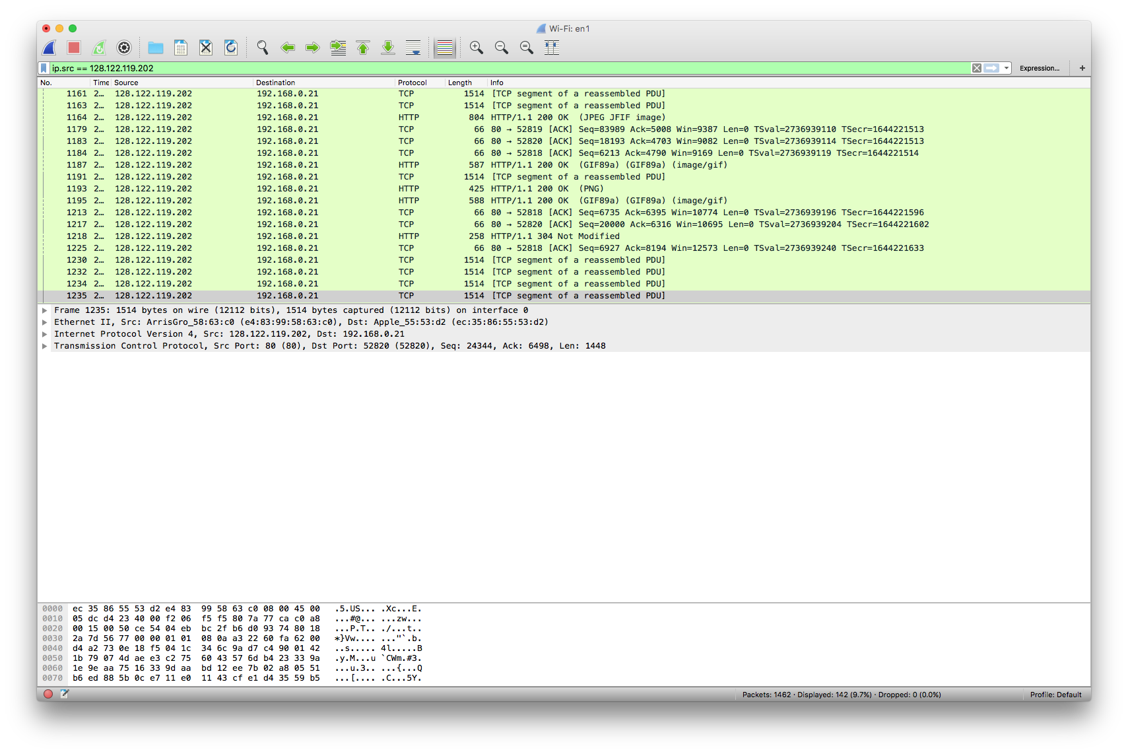
Filters

Slide 15
Filters
Wireshark uses display filters for general packet filtering while viewing packets.
Examples:
Show only traffic in the LAN (192.168.x.x), between workstations and servers -- no Internet:
ip.src==192.168.0.0/16 and ip.dst==192.168.0.0/16
Filter out any traffic to or from 10.43.54.65:
ip.addr != 10.43.54.65
Follow a UDP Flow:
(ip.addr eq 192.168.1.15 and ip.addr eq 192.168.1.9) and (udp.port eq 58445 and udp.port eq 52068)
More info on: http://wiki.wireshark.org/DisplayFilters

Slide 16
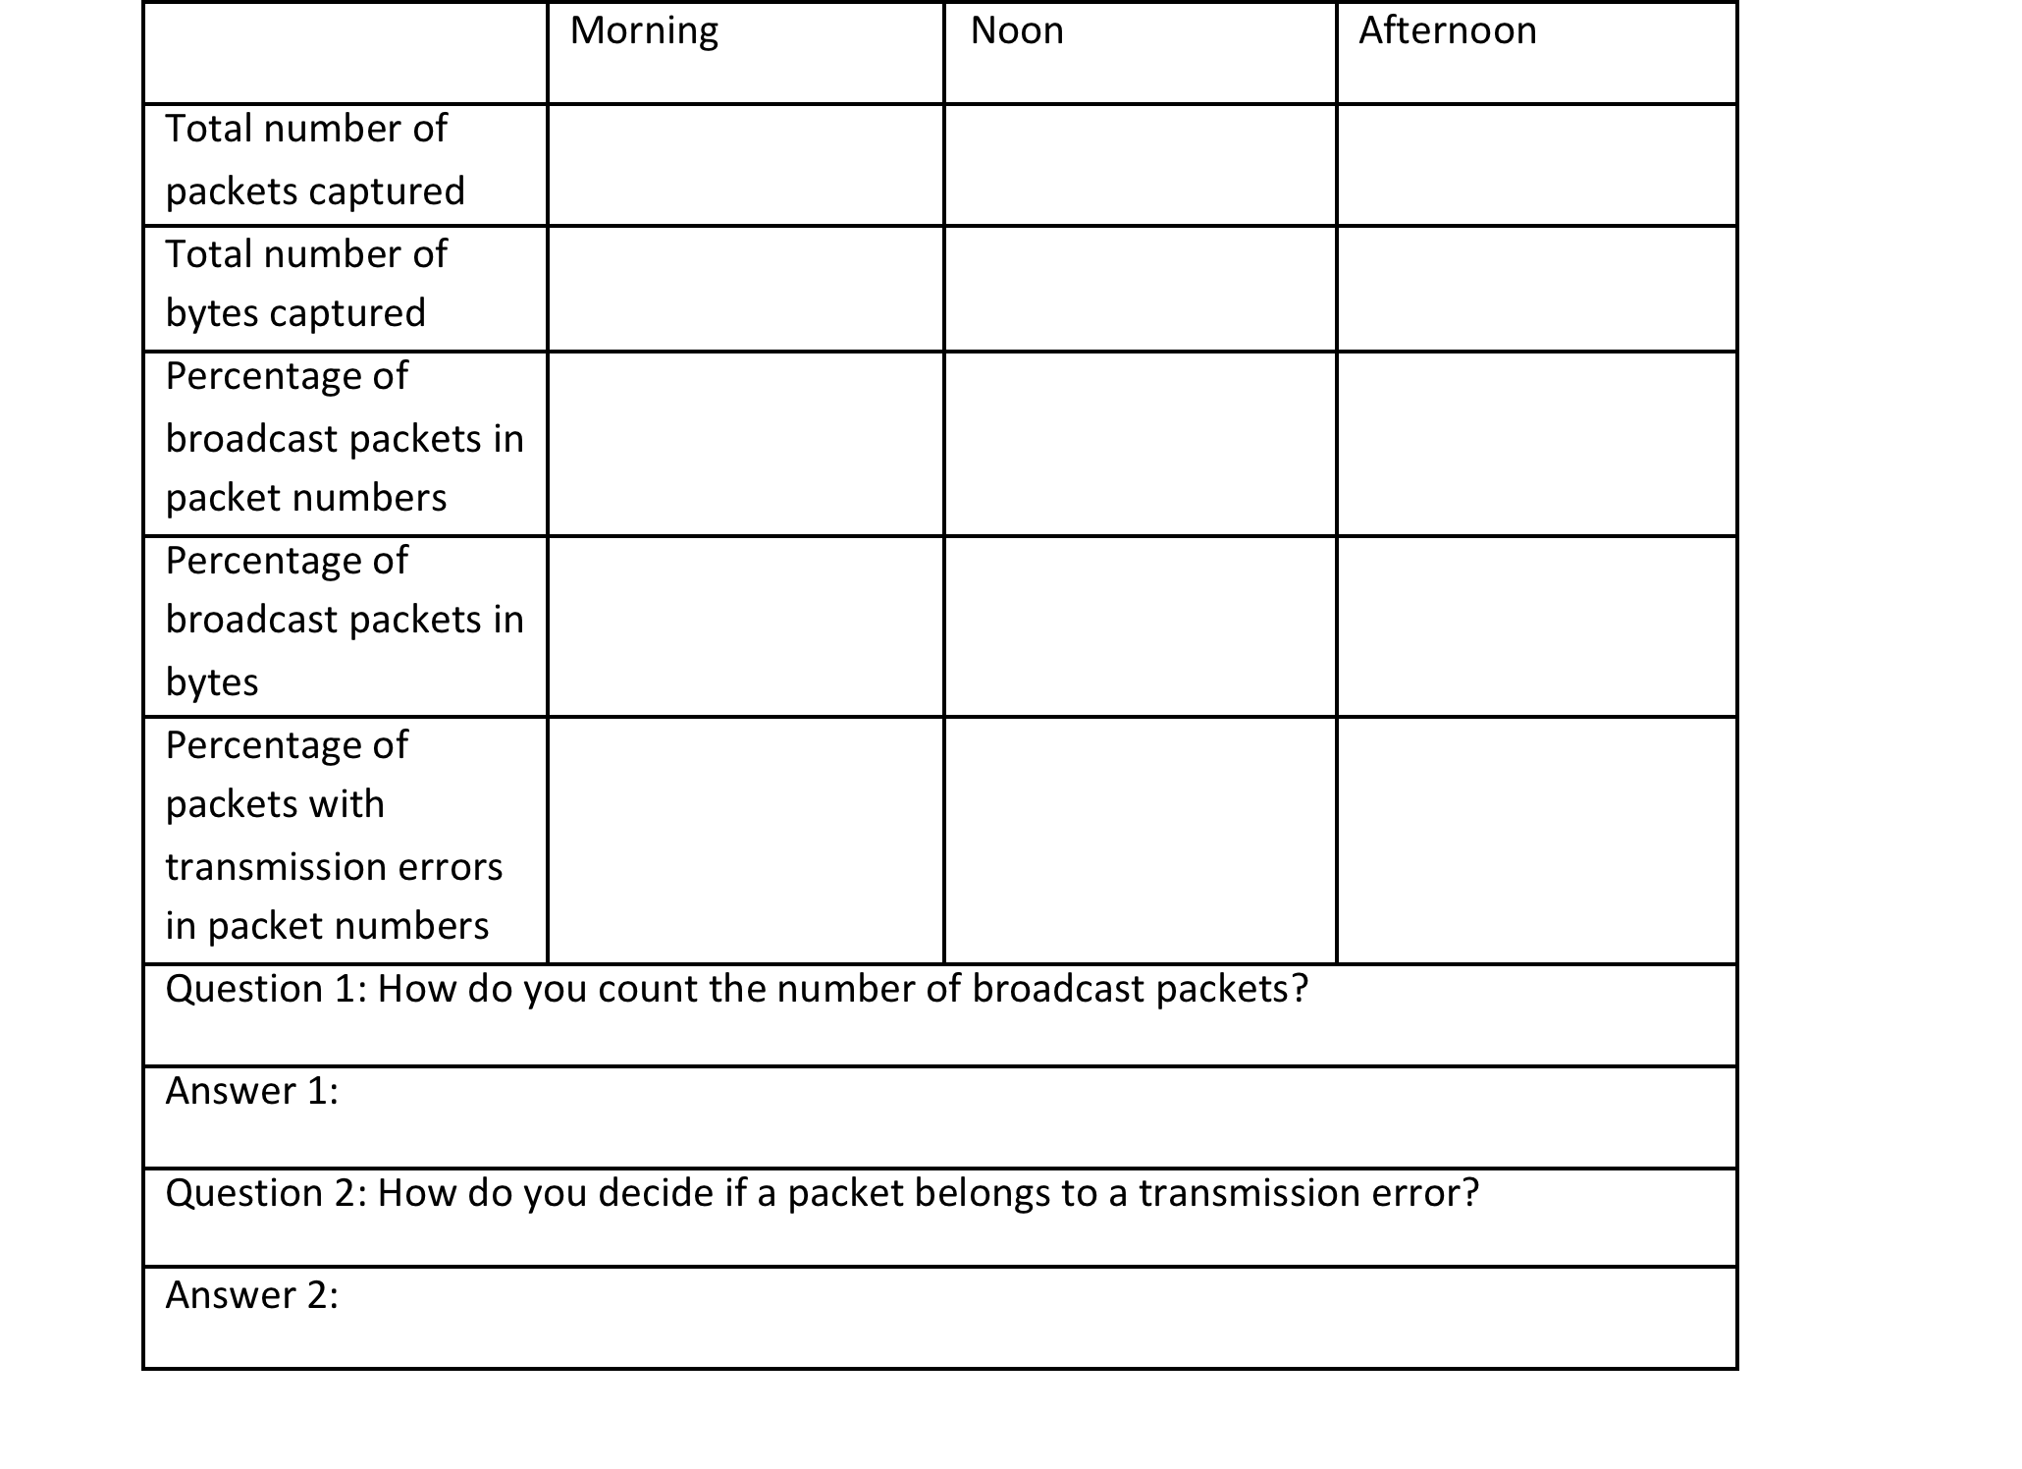
Wireshark sniffing (Table 1)

Slide 17


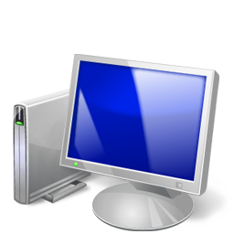

Capture Dropbox Operations (Table 2)
Dropbox client
sniffing

Slide 18
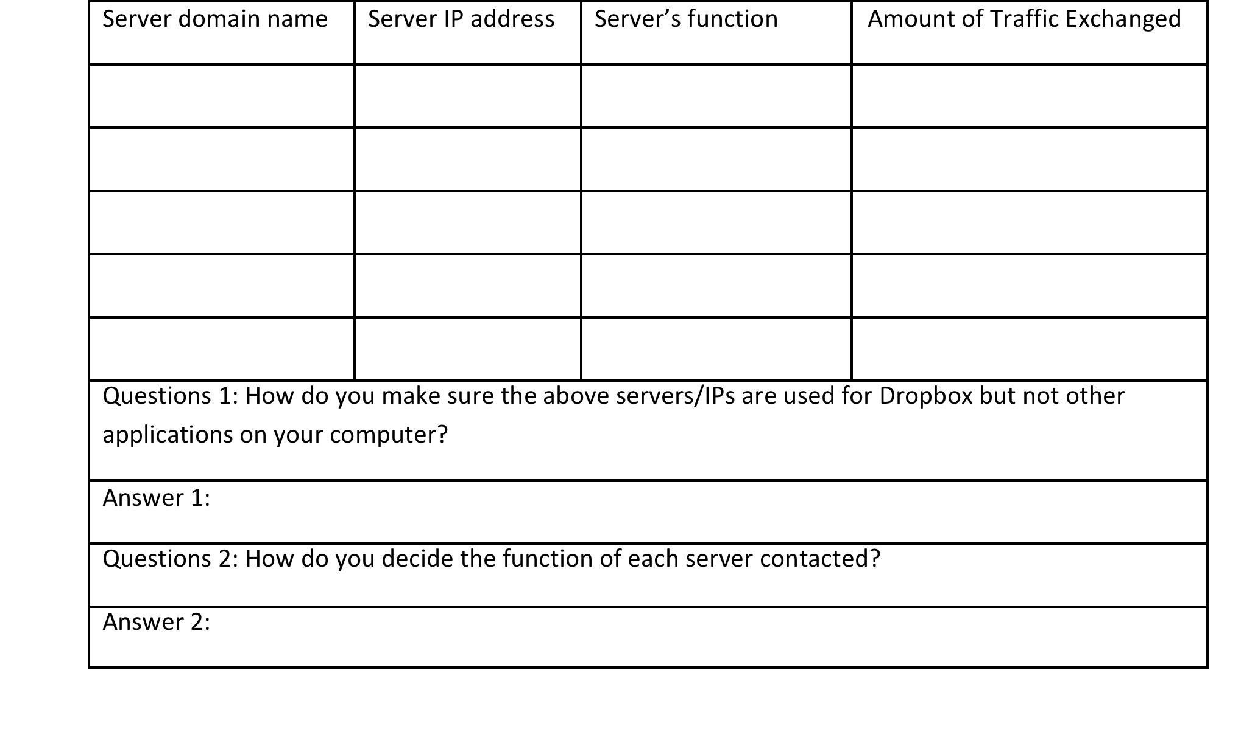
Capture Dropbox Operations (Table 2)

Slide 19

Dropbox and GoogleDrive Comparison (Table 3)
subnet 1
subnet 2
computer A
computer B
File Size:
1 MB
10MB
100MB
(use text file)
T1 (start)
T2 (end)

Slide 20
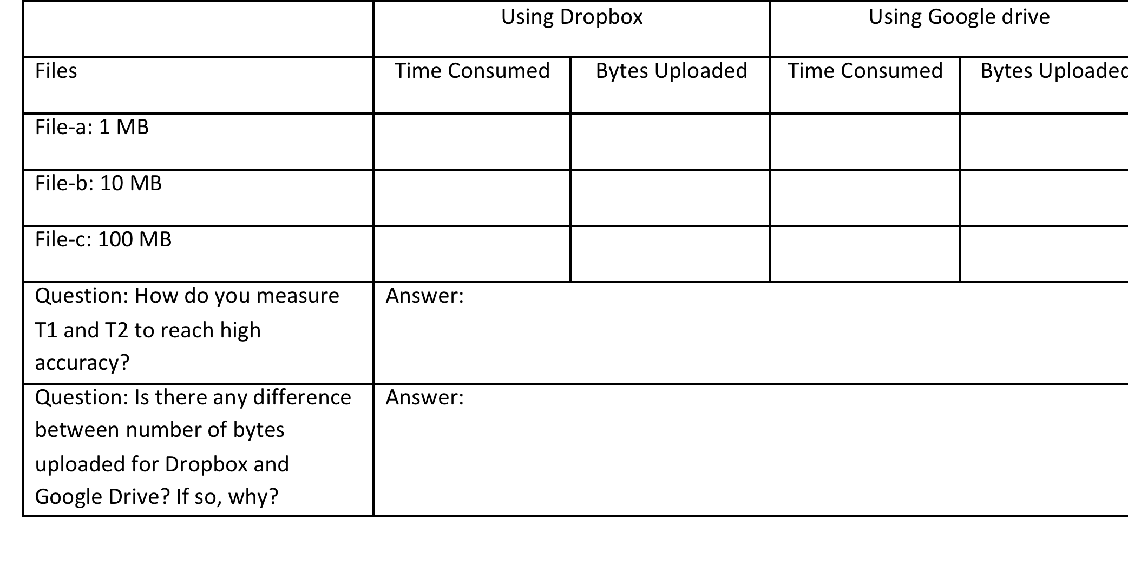
Dropbox and GoogleDrive Comparison (Table 3)

Slide 21

Dropbox and GoogleDrive Comparison (Table 4)
sync-ed
how many bytes transferred?
new
File-c (100MB)
File-c copy (100MB)

Slide 22
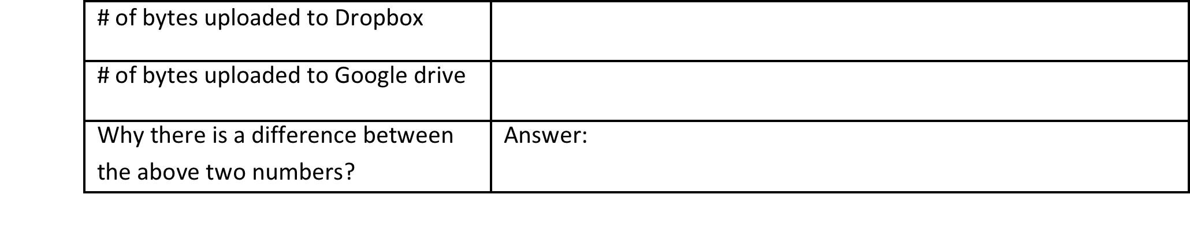
Dropbox and GoogleDrive Comparison (Table 4)

